Slide 1
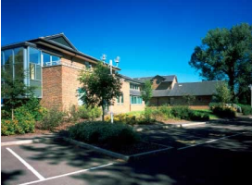
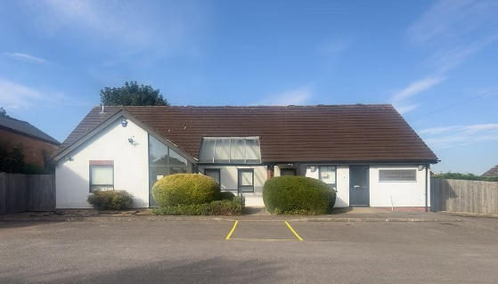
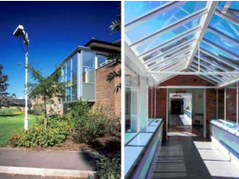
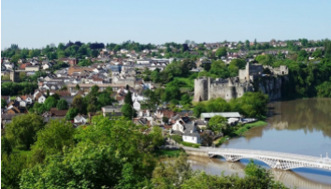
Permanent Salaried GP Required – 4 Sessions Mount Pleasant Practice Chepstow Community Hospital, Tempest Way, NP16 5XR, 01291 440154
Permanent Salaried GP
4 Sessions
Why Choose Mount Pleasant Practice?
Flexible Appointment System: We offer a mix of 10 and 15-minute face-to-face consultations and telephone consultations.
Supportive Team: Our practice is made up of a diverse, skilled team, including ANP, Pharmacist, Pharmacist Technician, and a Physiotherapist who holds weekly appointments. This helps reduce pressure on our GPs and ensures patients are supported by the right professionals.
Streamlined Workflow: We are an EMIS Web practice, and we use the Klink triage system to optimize patient flow. With all necessary patient information pre-screened and available before consultations.
Minimal Admin: Our use of Workflow and Pathology Go helps to reduce administrative tasks, enabling earlier finish times.
Beautiful Location: Situated in an area of outstanding Natural Beauty (AONB), our practice serves a resilient, welcoming community, with excellent schools and access to rural market towns.
Supportive Environment: We offer a friendly, collaborative team ethos with regular team-building events and bi-annual clinical team meals.
Are you a GP looking for a supportive, forward-thinking practice? At Mount Pleasant Practice, we’re looking for a permanent salaried GP who values teamwork and a collaborative environment to join our skilled, clinical team, starting in 2025.
Role Details
Start Date: March 2025
Salary: Starting at £10,450 per session.
6 weeks annual leave & one-week study leave pro rata.
Support with a Tier 2 visa if required, subject to approval by the GMC and GP Performers List.
To Apply
Applications in writing for the attention of: Ebony Christie-Durham
Email: FAO Ebony to: Admin.W93021@wales.nhs.uk
Closing date: Friday 14th of February 2025

